Slide 1
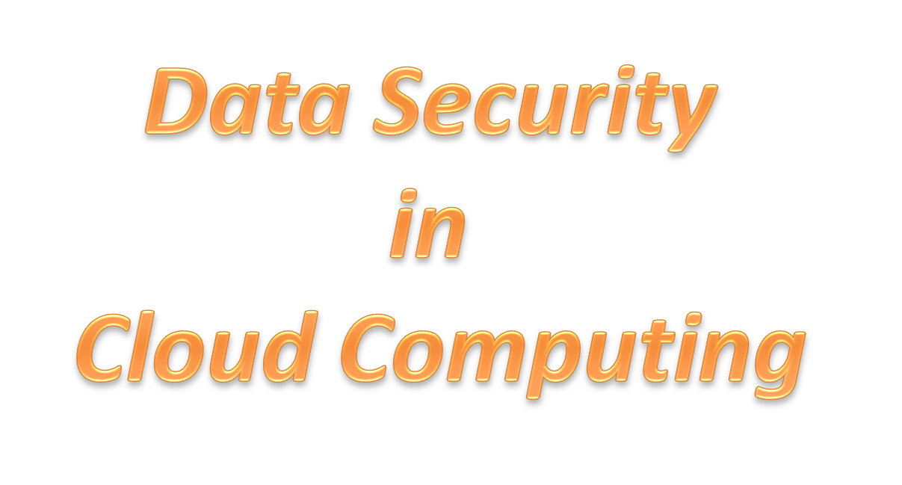


Slide 2

INTRODUCTION
AIM AND OBJECTIVES
SCOPE
LITERATURE REVIEW
ANALYSIS OF THE EXISTING SYSTEM
PROPOSED SYSTEM
METHODOLOGY
CONCLUSION
REFERENCES

Slide 3

Cloud computing has been envisioned as the next-generation architecture of IT enterprise. In contrast to traditional solutions, where the IT services are under proper physical, logical and personnel controls, cloud computing moves the application software and databases to the large data centers, where the management of the data and services may not be fully trustworthy. This unique attribute, however, poses many new security challenges which have not been well understood. In this article, we focus on cloud data storage security, which has always been an important aspect of quality of service. To ensure the correctness of users' data in the cloud, we propose an effective and flexible distributed scheme with two salient features, opposing to its predecessors. By utilizing the homomorphic token with distributed verification of erasure-coded data, our scheme achieves the integration of storage correctness insurance and data error localization, i.e., the identification of misbehaving server (s). Unlike most prior works, the new scheme further supports secure and efficient dynamic operations on data blocks, including: data update, delete and append. Extensive security and performance analysis shows that the proposed scheme is highly efficient and resilient against Byzantine failure, malicious data modification attack, and even server colluding attacks.

Slide 4
What is cloud Computing?
key to the definition of cloud computing is the “cloud” itself. here cloud is the group of large group of interconnected computers
these computers can be personal or network servers.
the cloud of computers extend beyond a single company or entity. the application and data served by cloud are available to broader group of users, cross enterprise, and cross platform.
access is via internet. any authorized user can access these documents, application from any computer over the internet.

Slide 5
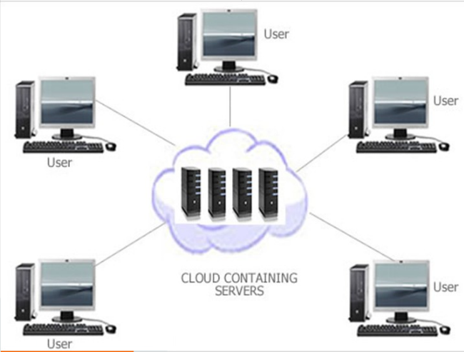

Slide 6
Key properties to cloud Computing
user centric:- once user connected with cloud, user can access images data messages applications, whatever- becomes authorized to the user access.
task centric:- instead of focusing on the application ,here the focus is on what one need to be done and the application customized for us.
powerful:- connecting hundreds of thousands of computers together in a cloud creates a wealth of computing power which is impossible for single desktop pc.
accessible:- because data is stored in cloud user can retrieve more information from multiple repositories

Slide 7
intelligent:- with all the data stored in computers of cloud, data mining and analysis are necessary to access that information in an intelligent manner.
programmable:- many of the task necessary with the cloud must be automated. for eg data to protect the integrity of data information stored on single computer must be replicable on other computers in cloud. If one computer goes offline cloud’s programming automatically redistributes the data to other computers.

Slide 8

The aim of this research work is to develop an application that explains how to ensure data security in Cloud Computing

Slide 9
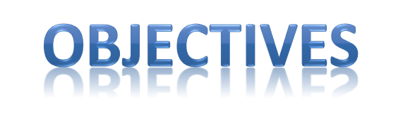
To examine the overview of cloud computing uses and challenges in relation to common recordkeeping practices (report)
To expantiate guidance for assessing risks and opportunities when outsourcing processes or information storage to the cloud (toolkit)
To assess the extent of cloud computing usage as well as the general interest in this new technology delivery model within the information professions
To provide use cases of cloud computing that have relevance to records and information management professionals‟ working environments

Slide 10

To identify some of the business benefits as well as legal, operational and technical challenges of cloud computing
To form a basis for the on-going development of good practice guidelines which information professionals can apply as applicable to their organizational contexts.
To develop an application that simulate the usage of cloud for data security.
To make recommendations for further research in the area of cloud computing and recordkeeping.
To examine the use of One Time Password as a means of data security to make sure only authorized user can access it.

Slide 11

The scope of this report is to consider uses, challenges and benefits of storing information in the cloud.
Research findings are based on consultation with information professionals which was specifically aimed at records and information managers, archivists and to some extent librarians.
It was outside the scope to consult with the wider IT or legal communities. The report considers all cloud computing service models (SaaS, IaaS and PaaS) where information is stored or processed on the cloud providers‟ infrastructure. Social media (or web 2.0) was not a main focus of the project and is only considered as part of the SaaS environment where information is stored in the cloud. Due to the small scale of this project, digital preservation considerations were not in scope but it is recommended that they be considered in a separate project. With this project, I was able to analyse the fact that cloud computing create personal safe for users whereby they can only access their information via proper verification with the use of OTP.

Slide 12

A thorough literature review has been conducted in preparation for the following project methods and to inform findings and recommendations. There is a vast amount of literature on cloud computing in general available online. However, much of it is either in the form of white papers from cloud providers or focussed on information technology aspects of cloud computing such as server virtualisation, infrastructure security and identity management. Few studies are available that focus on organisational or information management aspects such as life-cycle management, compliance or risk management. Most notable here is a study by the European Network and Information Security Agency (ENISA) on the risks and benefits of cloud computing for SMEs which also contains recommendations regarding information security in the cloud.

Slide 13
Even fewer sources concern themselves with the more specific relationship between cloud computing and records and information management. In that sense, the literature review provided a first indication of the fact that cloud computing is still in an early adoption stage in which technical concerns and product reviews dominate.
Thorough analysis of the state of cloud computing and the development of cloud standards and strategies are widely missing. However, a recent JISC study on cloud computing for research produced two reports analysing cloud computing barriers and drivers which also provide research-focused use cases and technical specifications for cloud computing. A list of cloud computing resources relevant to the records and information management community has been made available on Google Docs and can be accessed at https://docs.google.com/Doc?docid=0AUMD4SCCg7uaZGRxczNybndfMTZjODM4bXhmNw&hl=en. Everyone can contribute further relevant resources to the Google document. Online resources have been bookmarked in Delicious and are available at http://www.delicious.com/nicoleschu/soacloud

Slide 14
Most people that has worked on Cloud Computing have only just discussed about it but not actually put it into implementation.
For instance,
MAHESWARAN.M, 2008 of SCHOOL OF ENGINEERING COCHIN UNIVERSITY OF SCIENCE AND TECHNOLOGY, COCHIN in his journal titled “Cloud Computing” explaine the characteristics of Cloud computing, compare the google invented storage mechanism and IBM storage without laying reference on the security issues of cloud computing.
Nicole Convery, 2010 explain the concept of storing data in his journal without actually showing how it is done.
Abhirup Ghosh, 2011 of Department of Computer Science and Engineering Indian Institute of Technology, Bombay Powai, Mumbai. Explained the importance of storing data on the cloud only referencing the Google drive as an example of cloud storage
Prashant Guptaunder, 2014 of Invertis Institute of Engineering and Management, Bareilly evaluated the common cloud storage available and he made report on them and neither bringing out a security technique that can be adopted to ensure security nor implement it.

Slide 15


From the perspective of data security, which has always been an important aspect of quality of service, Cloud Computing inevitably poses new challenging security threats for number of reasons. The existing system only uses normal authentication of username and password to access the cloud data which can be attacked
Firstly, traditional cryptographic primitives for the purpose of data security protection can not be directly adopted due to the users’ loss control of data under Cloud Computing.
2. It provide less data security as it only uses logon credentials as the means of authentication, etc.

Slide 16


In this paper, we propose an effective and flexible distributed scheme with explicit dynamic data support to ensure the correctness of users’ data in the cloud. We rely on erasure correcting code in the file distribution preparation to provide redundancies and guarantee the data dependability. This construction drastically reduces the communication and storage overhead as compared to the traditional replication-based file distribution techniques.
Compared to many of its predecessors, which only provide binary results about the storage state across the distributed servers, the challenge-response protocol in my work further provides the localization of data error.
Unlike most prior works for ensuring remote data integrity, the new scheme supports secure and efficient dynamic operations on data blocks, including: accessing data only after proper authentication using One Time Password.
Extensive security and performance analysis shows that the proposed scheme is highly efficient and resilient against Byzantine failure, malicious data modification attack, and even server colluding attacks.

Slide 17
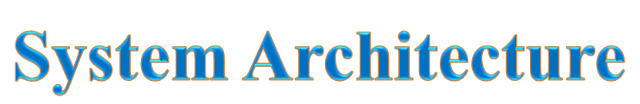

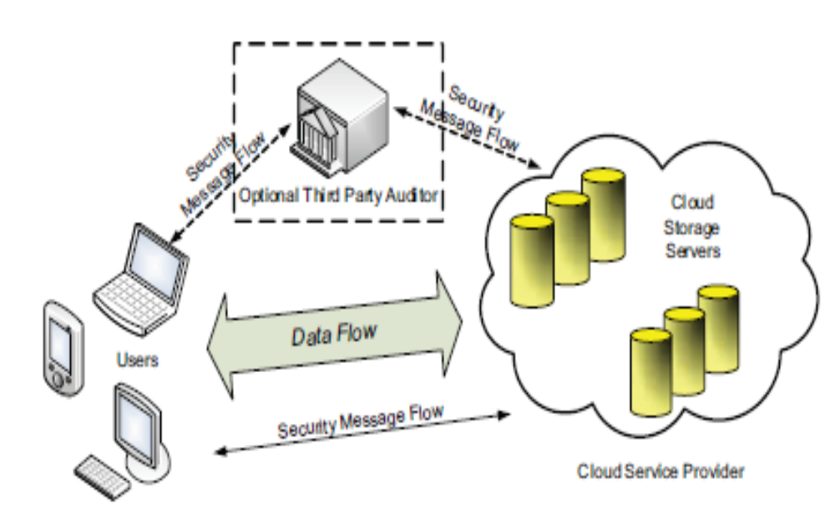

Slide 18
METHODLOGY
This system was developed using the following technologies:
HTML for building the structure
CSS for stylesheeting
JS for authentication
PHP as scripting language.
MYSQL for database management.
SMS API for sms gateway connection
The system has 5 main modules:
The Client Module and
The server module.
Cloud Data Storage
Cloud Authentication server
Adversary module

Slide 19
modules
1. Client Module:
In this module, the client sends the query to the server. Based on the query the server sends the corresponding data to the client.
2. System Module:
• User:
Users, who have data to be stored in the cloud and rely on the cloud for data computation, consist of both individual consumers and organizations.
• Cloud Service Provider (CSP):
A CSP, who has significant resources and expertise in building and managing distributed cloud storage servers, owns and operates live Cloud Computing systems,.
• Third Party Auditor (TPA):
An optional TPA, who has expertise and capabilities that users may not have, is Trusted to assess and expose risk of cloud storage services on behalf of the users upon request.

Slide 20
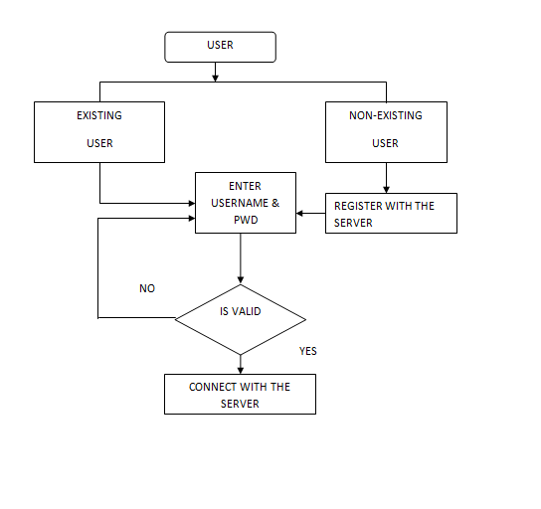
CLIENT

Slide 21
3. Cloud data storage Module:
Cloud data storage, a user stores his data through a CSP into a set of cloud servers, which are running in a simultaneous, the user interacts with the cloud servers via CSP to access or retrieve his data.
4. Cloud Authentication Server:
The Authentication Server (AS) functions as any AS would with a few additional behaviors added to the typical client-authentication protocol. The first addition is the sending of the client authentication information to the masquerading router.
The other optional function that should be supported by the AS is the updating of client lists.
5. Data Encryption:
One of the thing that make this system effective is that, user can decide to encrypt his/her own data.

Slide 22
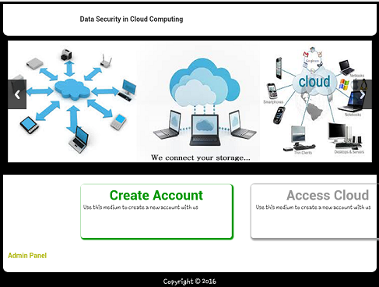
screen shots
HomePage

Slide 23
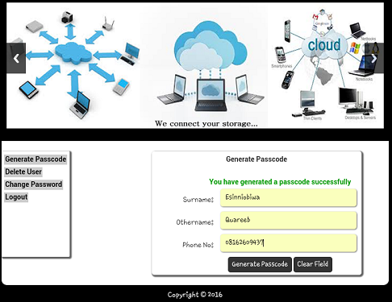
Password Generation page

Slide 24
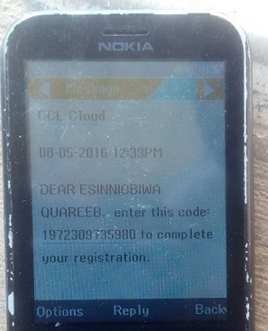


Slide 25
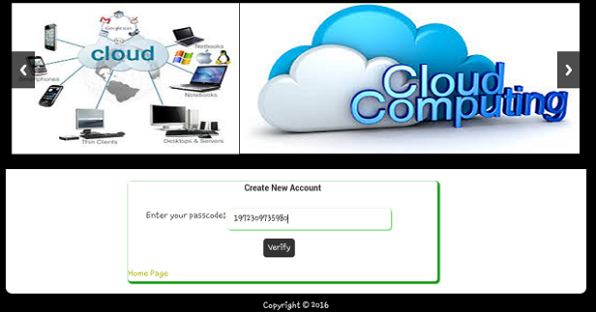


Slide 26
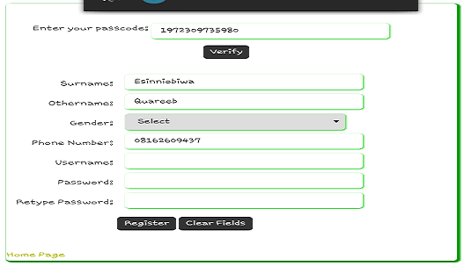


Slide 27
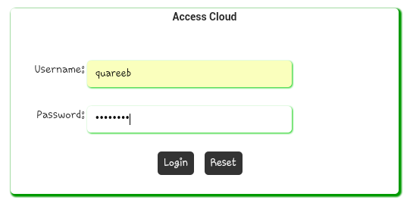
Access Cloud Login

Slide 28
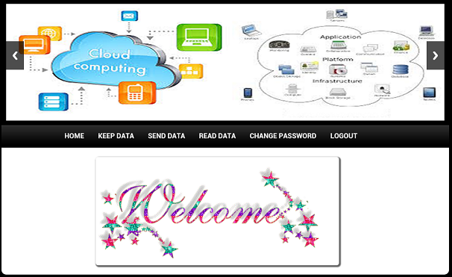
User Dashboard in Cloud

Slide 29
Conclusion
Cloud computing provides a supercomputing power. the cloud of computers extend beyond a single company or enterprise.
To ensure the correctness of users’ data in cloud data storage, I proposed an effective and flexible distributed scheme with explicit dynamic data support, including block update, delete, and append.
I believe that data storage security in Cloud Computing, an area full of challenges and of paramount importance, is still in its infancy now, and many research problems are yet to be identified

Slide 30
References
L. Carter and M. Wegman, “Universal Hash Functions,” Journal of Computer and System Sciences, vol. 18, no. 2, pp. 143–154, 1979.
J. Hendricks, G. Ganger, and M. Reiter, “Verifying Distributed Erasurecoded Data,” Proc. 26th ACM Symposium on Principles of Distributed Computing, pp. 139–146, 2007.
J. S. Plank and Y. Ding, “Note: Correction to the 1997 Tutorial on Reed-Solomon Coding,” University of Tennessee, Tech. Rep. CS-03504, 2003.
Q. Wang, K. Ren, W. Lou, and Y. Zhang, “Dependable and Secure Sensor Data Storage with Dynamic Integrity Assurance,” Proc. of IEEE INFOCOM, 2009.
R. Curtmola, O. Khan, R. Burns, and G. Ateniese, “MR-PDP: MultipleReplica Provable Data Possession,” Proc. of ICDCS ’08, pp. 411–420, 2008.
D. L. G. Filho and P. S. L. M. Barreto, “Demonstrating Data Possession and Uncheatable Data Transfer,” Cryptology ePrint Archive, Report 2006/150, 2006, http://eprint.iacr.org/.
M. A. Shah, M. Baker, J. C. Mogul, and R. Swaminathan, “Auditing to Keep Online Storage Services Honest,” Proc. 11th USENIX Workshop on Hot Topics in Operating Systems (HOTOS ’07), pp. 1–6, 2007.
http://www.infoworld.com/article/08/04/07/15FE-cloud-computing-reality_1.html,
“What Cloud Computing Really Means” http://www.spinnakerlabs.com/CloudComputin g.pdf
Welcome to the new era of cloud computing PPT” http://www.johnmwillis.com/ “Demystifying Clouds” - discusses many players in the cloud space

Slide 31
Amazon.com, “Amazon Web Services (AWS),” Online at http://aws. amazon.com, 2008.
N. Gohring, “Amazon’s S3 down for several hours,” Online at http://www.pcworld.com/businesscenter/article/142549/amazons s3 down for several hours.html, 2008.
A. Juels and J. Burton S. Kaliski, “PORs: Proofs of Retrievability for Large Files,” Proc. of CCS ’07, pp. 584–597, 2007.
H. Shacham and B. Waters, “Compact Proofs of Retrievability,” Proc. of Asiacrypt ’08, Dec. 2008.
K. D. Bowers, A. Juels, and A. Oprea, “Proofs of Retrievability: Theory and Implementation,” Cryptology ePrint Archive, Report 2008/175, 2008, http://eprint.iacr.org/.
G. Ateniese, R. Burns, R. Curtmola, J. Herring, L. Kissner, Z. Peterson, and D. Song, “Provable Data Possession at Untrusted Stores,” Proc. of CCS ’07, pp. 598–609, 2007.
G. Ateniese, R. D. Pietro, L. V. Mancini, and G. Tsudik, “Scalable and Efﬁcient Provable Data Possession,” Proc. of SecureComm ’08, pp. 1– 10, 2008.
T. S. J. Schwarz and E. L. Miller, “Store, Forget, and Check: Using Algebraic Signatures to Check Remotely Administered Storage,” Proc. of ICDCS ’06, pp. 12–12, 2006.
M. Lillibridge, S. Elnikety, A. Birrell, M. Burrows, and M. Isard, “A Cooperative Internet Backup Scheme,” Proc. of the 2003 USENIX Annual Technical Conference (General Track), pp. 29–41, 2003.
K. D. Bowers, A. Juels, and A. Oprea, “HAIL: A High-Availability and Integrity Layer for Cloud Storage,” Cryptology ePrint Archive, Report 2008/489, 2008, http://eprint.iacr.org/.

